Slide 1
Renewable Diesel Company Name: RAM Diesel Team M: Alex Attard, Mireille Miller, Riley Prosser
Advisors: Dr. Paul Schipper & Dr. Yushan Yan
Friday, May 14, 2021
Notes:
MM

Slide 2
Why Renewable Diesel?
Complies with the Reformulated Fuel Standards (RFS)
Renewable Diesel is made from hydrotreating vegetable or waste oils
RFS provides for federal incentives to produce
Federal and state tax credits for renewable diesel
Technical success
Hydrotreating and isomerization process technology has been demonstrated commercially
Reduces Greenhouse Gas Emissions by at least 50-85% compared to conventional diesel
Performs well in current diesel engines alone and in blends
Notes:
MM

Slide 3
Market Analysis
Market share: 5%
Production Rate: 250 MMGal RD/yr
Plant Location: Iowa
Customer: Large Corporations + Local Distributors
Sell everything we produce – demand is plentiful
Government Incentives:
Federal Tax Credit: $1/Gal
State Tax Credit - Iowa: $0.055/Gal
RFS RIN Credit: $0.80/Gal
Total Tax Credit: $463.8MM/yr
Notes:
AA

Slide 4
Feedstock Blends
Two blends explored – taking supply into account
Ideal Blend: maximize WCO, DCO
Realistic Blend: safer estimate in case WCO, DCO productions are low
~ 53.2¢/lb on average ~ 53.6¢/lb on average
Blend 1: Ideal Case |  | Blend 2: Realistic Case
Feedstock | Mass Fraction | Feedstock | Mass Fraction
Soybean Oil | 0.715 | Soybean Oil | 0.780
Waste Cooking Oil | 0.028 | Waste Cooking Oil | 0.020
Distillers Corn Oil | 0.257 | Distillers Corn Oil | 0.200
Notes:
AA

Slide 5
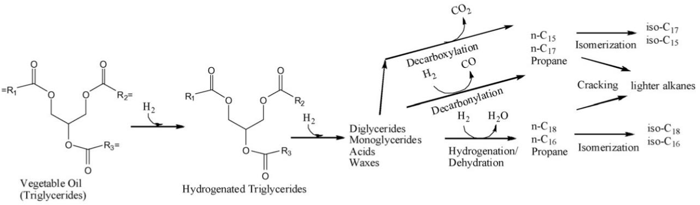


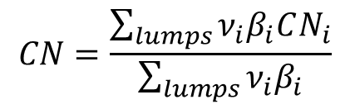
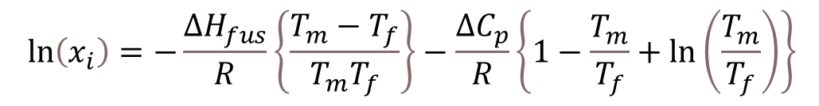
RD Properties & Chemistry
Cloud Point: $T_{f}$
Cetane Number: CN
$$\ln\left(x_{i}\right)=−\frac{ΔH_{fus}}{R}\left\{\frac{T_{m}−T_{f}}{T_{m}T_{f}}\right\}−\frac{ΔC_{p}}{R}\left\{1−\frac{T_{m}}{T_{f}}+\ln\left(\frac{T_{m}}{T_{f}}\right)\right\}$$
$$CN=\frac{\sum_{lumps}{ν_{i}β_{i}CN_{i}}}{\sum_{lumps}{ν_{i}β_{i}}}$$
U.S. Maximum: -$9°$C
U.S. Minimum: 40
Reactor 1
Reactor 2
Notes:
AA / MM

Slide 6
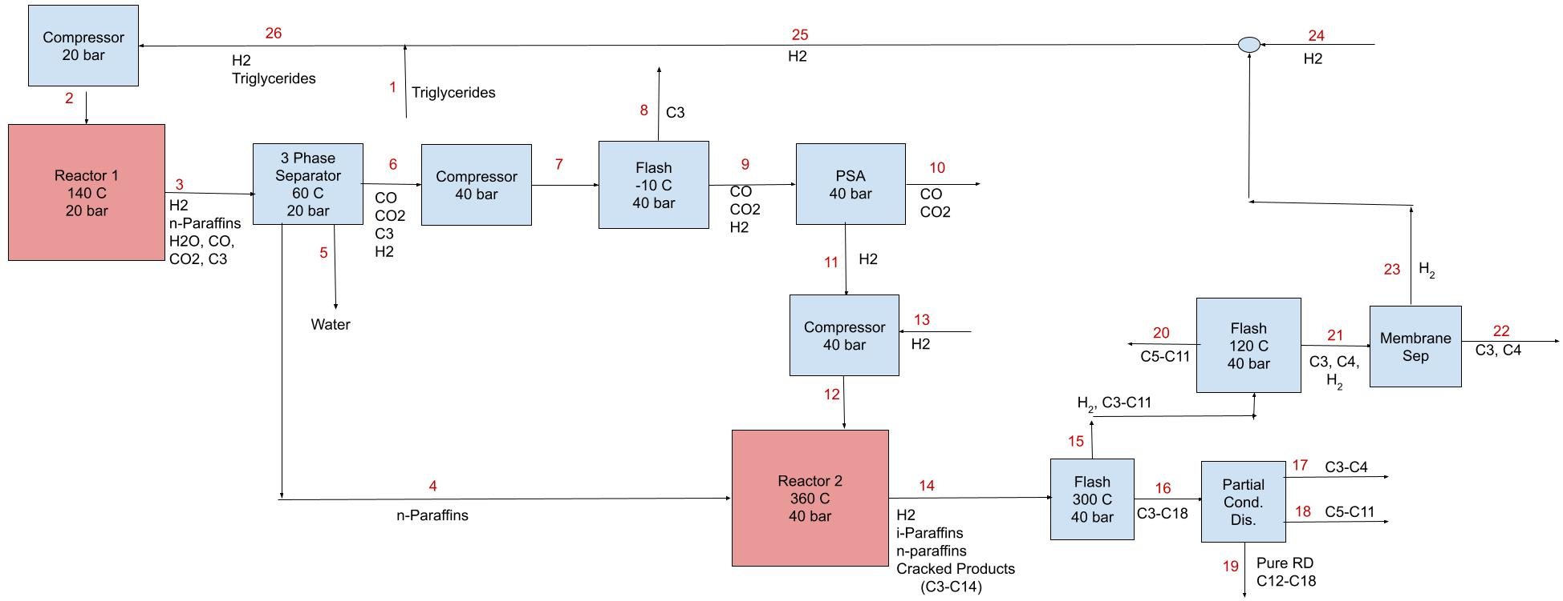
Product Flow Diagram
0.85 Conversion
0.30 Cracking
Notes:
MM

Slide 7
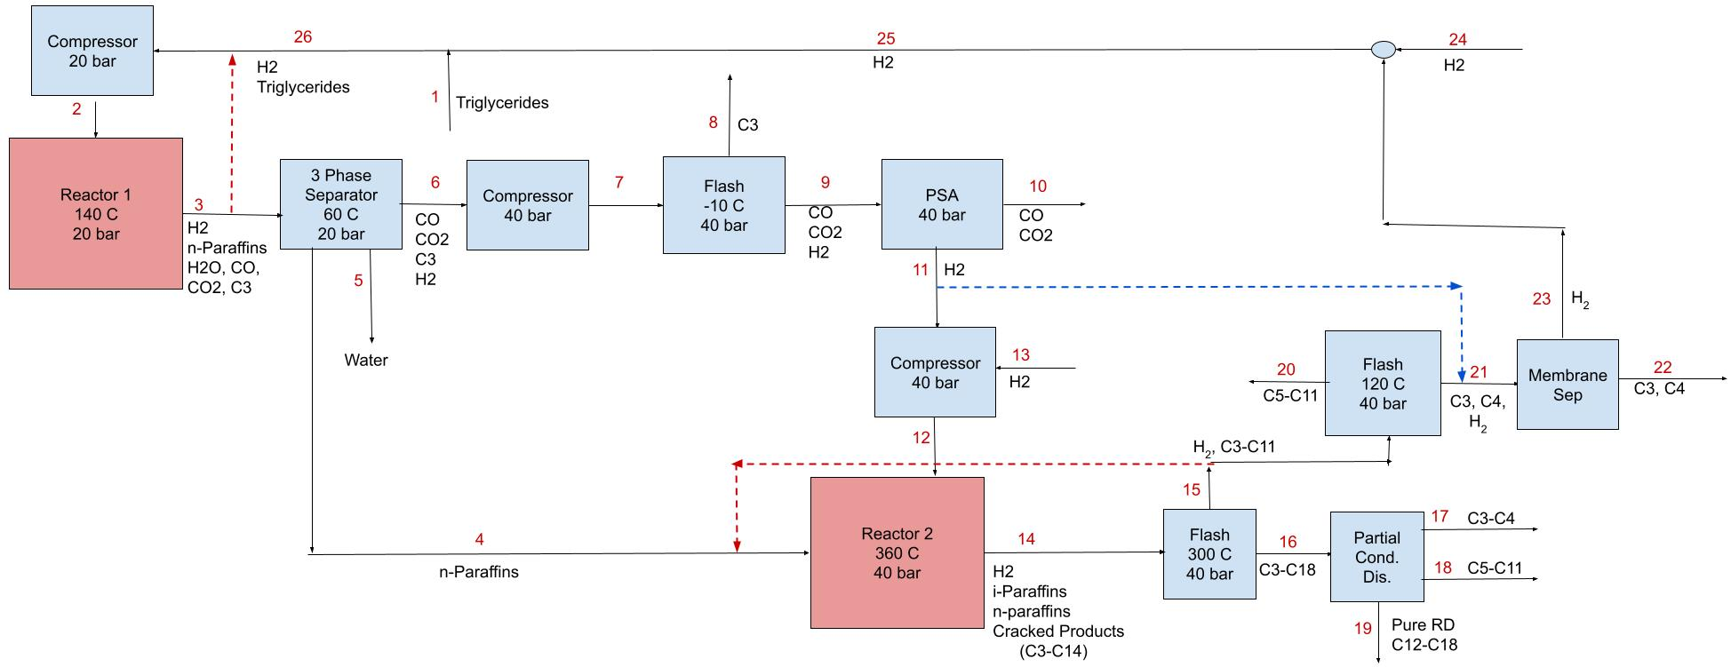
Product Flow Diagram + Heat Integration
0.85 Conversion
0.30 Cracking
Notes:
MM

Slide 8
Reactor 1
$$C_{57}H_{98}O_{6}+10.011 H_{2}→0.061 C_{18}H_{38}+2.576 C_{17}H_{36}+0.294 C_{16}H_{34}+0.0804 C_{15}H_{32}+C_{3}H_{8}+1.6 CO+1.6CO_{2}+1.2 H_{2}O$$
H₂ Feed:
H₂: x_{H2,2}Q₂ = 12x_{3G,1}Q₁
Triglyceride Feed:
118.9 kmol/hr to account for 30% cracking in Reactor 2
Run at 140 C and 20 bar
Paraffins​ | Soybean​ | Waste Cooking​ | Distillers Corn​
C15​ | 0.030 | 0.036 | 0.099
C16​ | 0.070 | 0.056 | 0.047
C17​ | 0.860 | 0.867 | 0.827
C18​ | 0.040 | 0.041 | 0.027
Total​ | 1.000 | 1.000 | 1.000
Notes:
MM

Slide 9
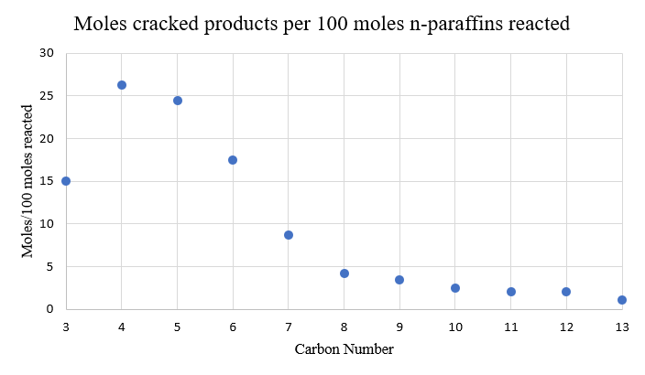
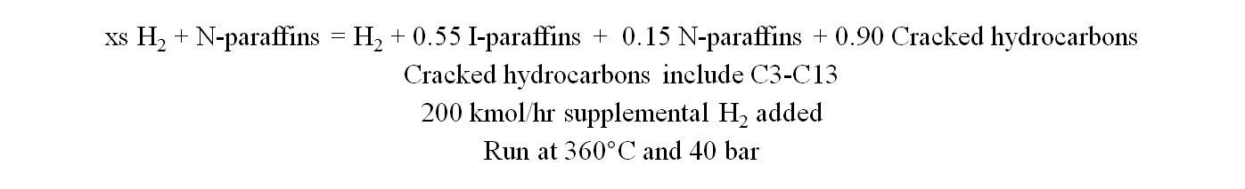
Reactor 2
xs H₂ + N-paraffins = H₂ + 0.55 I-paraffins + 0.15 N-paraffins + 0.90 Cracked hydrocarbons
Cracked hydrocarbons include C3-C13
200 kmol/hr supplemental H₂ added
Run at 360$°$C and 40 bar
Bouchy, C., et al. “Fischer-Tropsch Waxes Upgrading via Hydrocracking and Selective Hydroisomerization.” Oil & Gas Science and Technology - Revue De L'IFP, vol. 64, no. 1, 2009, pp. 91–112., doi:10.2516/ogst/2008047.
Notes:
MM

Slide 10


Product Specs: Cloud Point & Cetane Number
Final $T_{f}$ = -10.6$°$C
Final CN = 60.5
U.S. Maximum: -9$°$C
U.S. Minimum: 40
Notes:
AA -> higher mole frac give higher freezing point bc ln(xi) is larger
Emphasize that isomerization helps cloud point
85% isomerization in rctr 2, 30% overall cracking

Slide 11
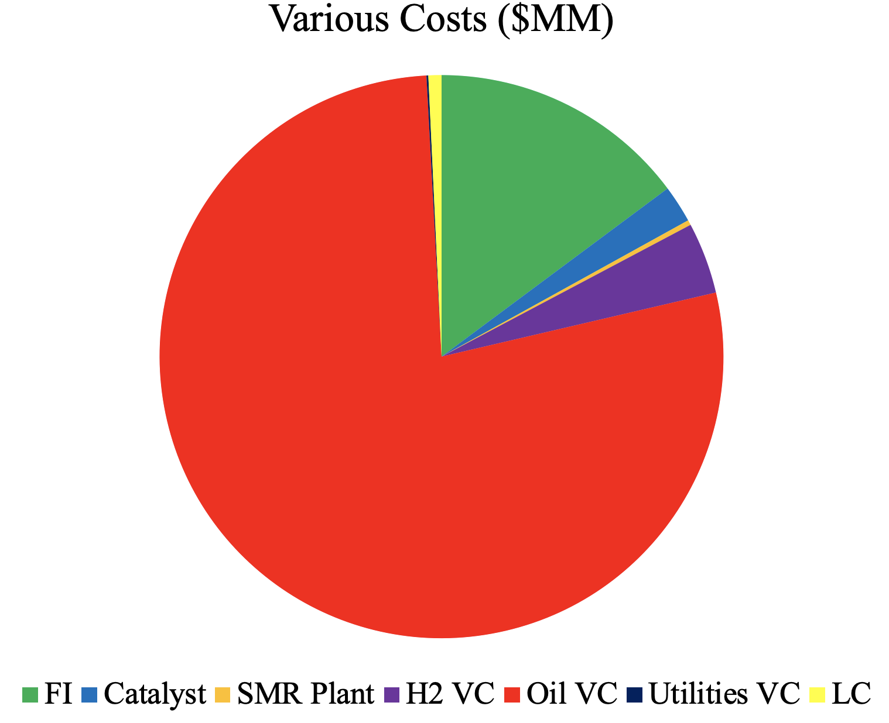
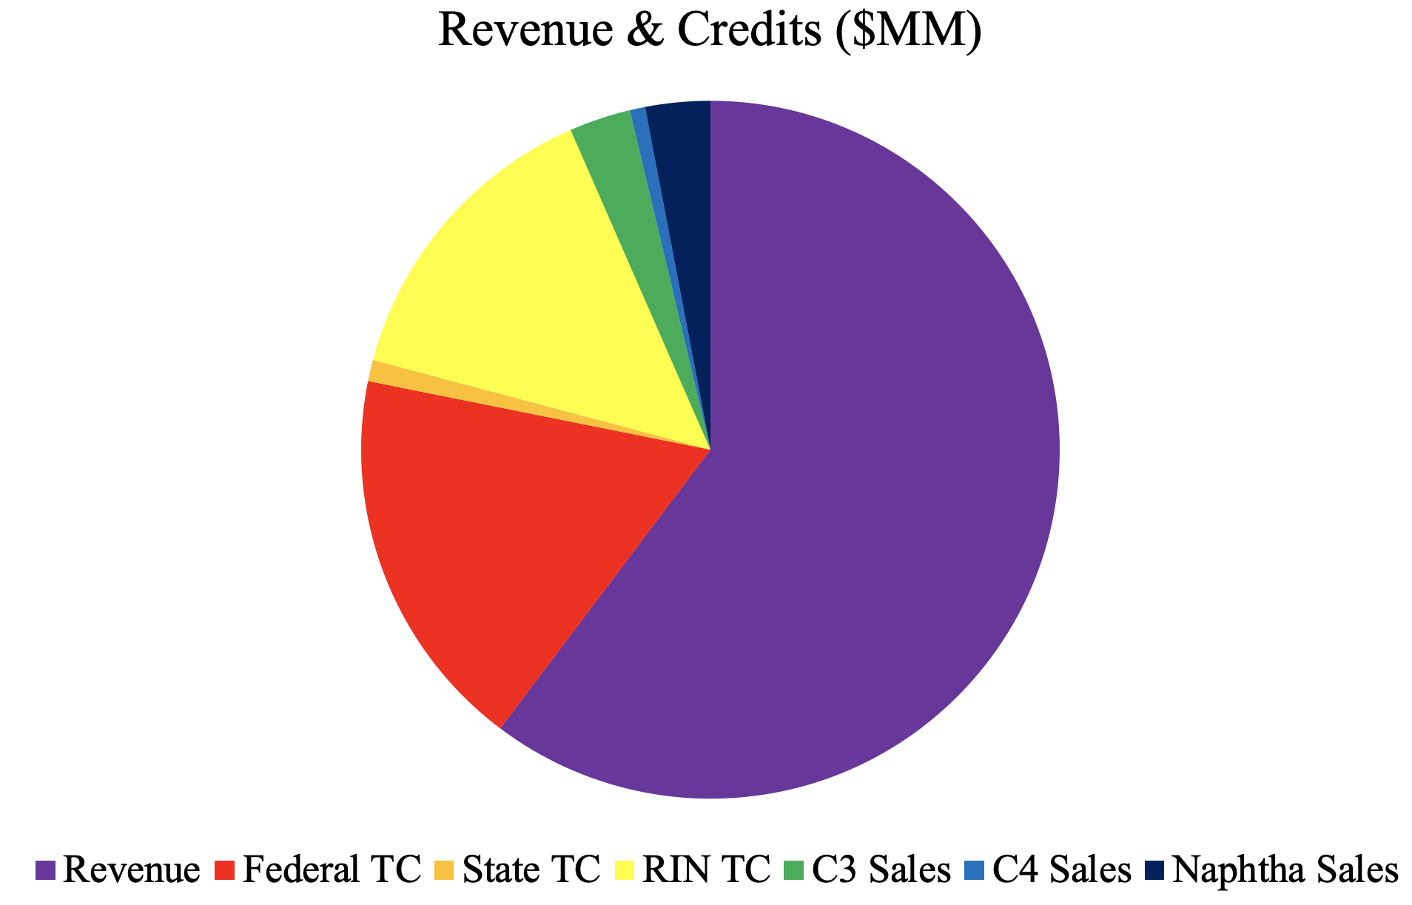
Sizing & Cost Analysis for the RD Process
Realistic Blend / SMR + CCS; VGA = $206.4MM
Most Expensive Equipment: compressors & distillation column
Heat Integration: lowered yearly utility costs from $6.2MM to $1.5MM
Notes:
AA

Slide 12
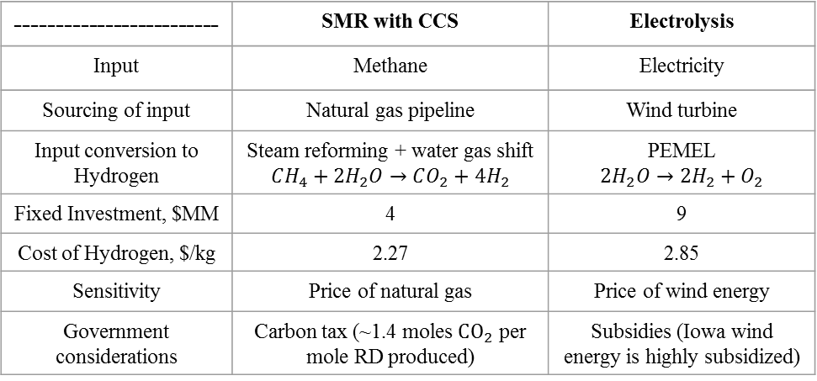
Sourcing and Sensitivity of Hydrogen
25 MM kg / year hydrogen requirement
Limited hydrogen suppliers local to Iowa, will plan to construct hydrogen production plant
Price of RD produced from SMR with CCS is $0.07/gal cheaper
Assessing government considerations:
------------------------- | SMR with CCS | Electrolysis
Input | Methane | Electricity
Sourcing of input | Natural gas pipeline | Wind turbine
Input conversion to Hydrogen | Steam reforming + water gas shift $$CH_{4}+2H_{2}O→CO_{2}+4H_{2}$$ | PEMEL $$2H_{2}O→2H_{2}+O_{2}$$
Fixed Investment, $MM | 4 | 9
Cost of Hydrogen, $/kg | 2.27 | 2.85
Sensitivity | Price of natural gas | Price of wind energy
Government considerations | Carbon tax (~1.4 moles $CO_{2}$ per mole RD produced) | Subsidies (Iowa wind energy is highly subsidized)
At current levels, a carbon tax of $136 / ton C would make SMR w CCS hydrogen cost equivalent to electrolysis. This is greater than what could be expected from a future carbon tax.
Iowa wind energy subsidies have been getting phased out since 2016.
Proceed with SMR w CCS hydrogen production
Notes:
RP

Slide 13
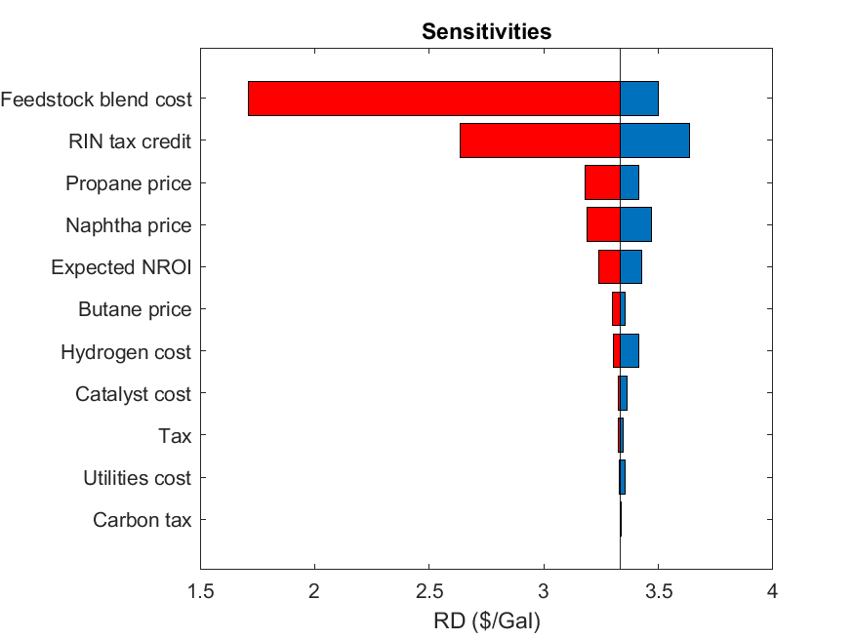
Overall Sensitivity Analysis
Most sensitive to cost of feedstock blend and price of RIN tax credit
If these two variables were to swing in our favor, price of RD could be reduced to below $2.50/gal
Next most significant factors are the sales prices of cracked products, these show much variability over the past 10 years and could influence profitability unpredictably.
Cost of hydrogen, catalyst, and utilities along with tax considerations are not so significant
Notes:
RP

Slide 14
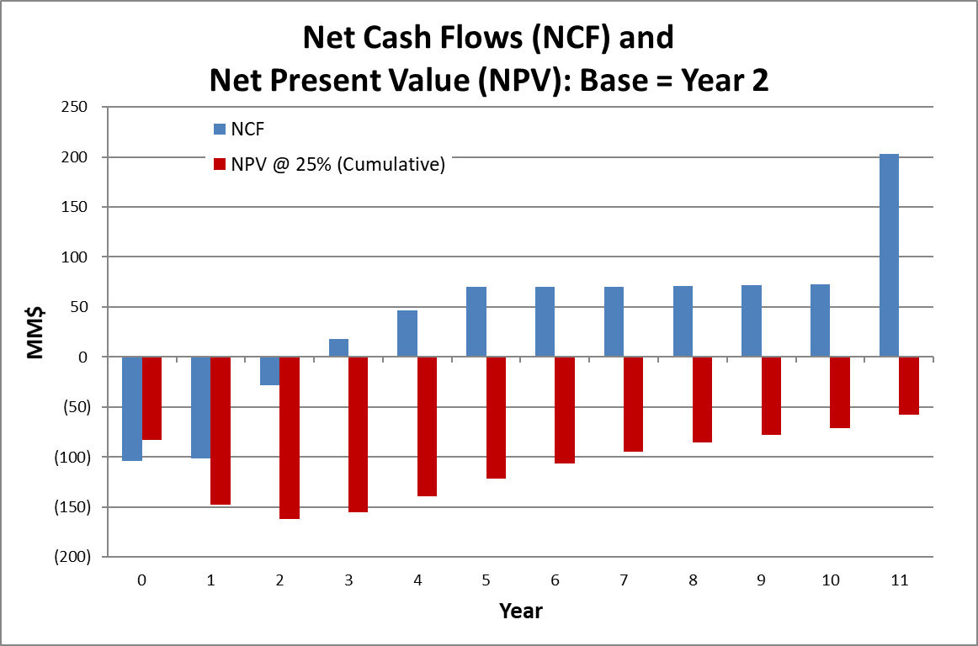
Economics
Scenario | RD Price/Gal
Ideal | $3.33
Realistic | $3.37
Price calculated for an NROI of 25% lead to:
Competative pricing compared to pure grade biodiesels
95% reduction in GHG emissions from production compared to conventional diesel
After 11 years:
NPV (i = 25%) = -$57.3MM
IRR =16.7%
Implementing a sales price of $3.50/gal results in a positive NPV after just 10 years.
Fuel Type | Fuel Price/Gal | Difference
Diesel | $2.64 | + 27.7%
Biodiesel (B99/B100) | $3.49 | - 3.44%
Notes:
RP

Slide 15
Summary and Suggestions
Resultant RD price level of $3.37 achieves a 25% NROI with a 16.7% IRR
Cloud point of -10.6°C and cetane number off 60.5 exceed U.S. specifications and allow our RD to be pass federal regulations
Economics are extremely sensitive to the price of the oil feedstock blend along with the RIN credit trading price
Significant reduction in GHG emissions provides resilience to any future carbon taxes
Move forward with pilot scale production of RD using hydrogen sourced from SMR w CCS and the realistic oil feedstock blend
Notes:
RP

Slide 16
References
[1] Bouchy, C., et al. “Fischer-Tropsch Waxes Upgrading via Hydrocracking and Selective Hydroisomerization.” Oil & Gas Science and Technology - Revue De L'IFP, vol. 64, no. 1, 2009, pp. 91–112., doi:10.2516/ogst/2008047.
[2] Calemma, V, et al. “Hydroisomerization and Hydrocracking of Long Chain n-Alkanes on Pt/Amorphous SiO2–Al2O3 Catalyst.” Applied Catalysis A: General, vol. 190, no. 1-2, 2000, pp. 207–218., doi:10.1016/s0926-860x(99)00292-6.
[3] Choi, Wan-Kyu, et al. “Optimal Operation of the Pressure Swing Adsorption (PSA) Process for CO2 Recovery.” Korean Journal of Chemical Engineering, vol. 20, no. 4, 2003, pp. 617–623., doi:10.1007/bf02706897.
[4] Ghosh; Jaffe., Detailed Composition-Based Model for Predicting the Cetane Number of Diesel Fuels, Ind. Eng. Chem. Res. 2006, 45, 1, 346–351
[5] Nathan W. Ockwig and Tina M. Nenoff. “Membranes for Hydrogen Separation”
Chemical Reviews. vol. 110, no. 4, 2010, pp. 2573-2574. DOI: 10.1021/cr078108l
[6] Suppes, SAE Transactions , 2000, Vol. 109, Section 4: Journal of Fuels and Lubricants (2000), pp. 1972-1987

Slide 17
Thank you for listening!
Questions?

Slide 18
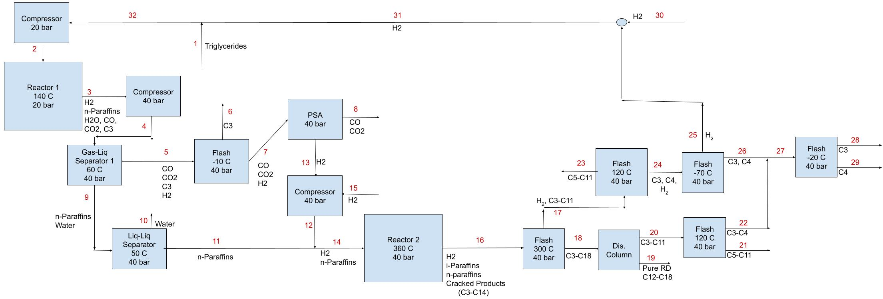
Preliminary Product Flow Diagram
0.85 Conversion
0.30 Cracking
Notes:
MM

Slide 19

Prelim Product Flow Diagram + Heat Integration
0.85 Conversion
0.30 Cracking
Notes:
MM

Slide 20
Variable | Low | High | Notes
Hydrogen cost ($/kg) | 2 | 3 | Typical range from H₂ produced by SMR w CCS
Feedstock blend cost ($/kg) | 0.77 | 1.21 | Cheapest feedstock (waste cooking oil) to most expensive (soybean oil)
Carbon tax ($ / ton C) | 0 | 5 | No carbon tax to a high but plausible tax level
Utilities cost ($MM/yr) | 0.75 | 6.2 | Half of the current utility cost level to costs before heat integration
Tax (%) | 10 | 14 | Around a 20% deviation from current tax level
RIN tax credit ($/gal) | 0.5 | 1.5 | Observed variation in RIN credit price over past 10 years
Catalyst cost ($/kg) | 3 | 4 | Based on prices of catalyst components
Naphtha price ($/ton) | 100 | 1,000 | Observed variation in naphtha price over past 10 years
Propane price ($/ton) | 200 | 800 | Observed variation in propane price over past 10 years
Butane price ($/ton) | 175 | 700 | Observed variation in butane price over past 10 years
Expected NROI (%) | 20 | 30 | Around a 20% deviation from current expected NROI
Cost of electricity from wind turbines:
0.2 – 0.6 $/kWh

